Slide 1
Software Engineering (CGE2C09)
By Jaelyn Lim Hui Wen, Leong Min En, Loh Shi Jia, Serene, Reyner Leong

Slide 2
Software Requirement Specification

Slide 3
System Functions
The following are the functions that are going to be implemented into the system.
Reservation System
Customer Management
Reporting System
Employee and Housekeeping Tracking
Invoices and Statements
Global Perspective
Flexible Payment Options

Slide 4
User Characteristics
There are 4 types of users that will be interacting with the system:
Hotel owners (Mr & Mrs Wang)
Staff (Manager, Receptionist)
System Administrator
Customers

Slide 5
Functional Requirements
Login and Logout
Room Availability and Booking Module
Housekeeping and Staff Management Module
Reporting Module
Guest profile and history module
User account and login creation Module
Searching Rooms
FAQ
Notes:
Login and Logout
The system will allow all users to login and logout of the system.
Login
The system will prompt the user for the login details; Staff ID and login password.
The system will check if the provided login details match with the login details in the database.
If there is a match found, the staff homepage page is loaded
If there is no match found, an error message will be displayed to inform the user to try again.
Logout
The system will log the user out when the user clicks on the “Logout” button.
Room Availability and Booking Module
Room Availability Management
The system will allow users (i.e. reception staff) to manage check-ins and checkouts.
The system will be able to check hotel room availability and will allocate respective rooms to the respective guests.
When checking out, additional charges will be recorded so that the total payable amount can appear for the guest to see.
Check-in
The system will prompt user with guest identification number.
With the identification number, they will be able to view the booking that was made. The booking will include the booking id, first name, last name, contact number, home and mailing address, email address, number of adults, number of children, type of room, check-in date and time, checkout date and time, payment type, credit card type, credit card number, credit card expired date and additional remarks.
If unable to find identification number with a booking, user will be shown an error message.
If able to find identification number with a booking, guest will be able to go to their rooms and the room status of that particular room will change from ‘Available’ to ‘Occupied’.
Checkout
The system will prompt for the guest identification number
Upon providing the identification number, the user will be able to view the room rates and add on the additional charges.
Upon checking out, the booking will be deleted from the system and an invoice will be generated.
After the guest has checked out, the room status will change from ‘Occupied’ to ‘Available’.
Room Booking Management
The system will allow users (i.e. reception staff) to manage guest bookings via call-in.
Guests can make booking through online themselves too.
Create booking
The system will display the following details when the user wants to create a new room booking; first and last name, contact number, home and mailing address, email address, number of adults, number of children, type of room, check-in date and time, checkout date and time, payment type, credit card type, credit card number, credit card expired date and additional remarks.
Users will be able to view the different room types and respective rates before entering their final decision
Upon choosing the room type, the room rate will be automatically displayed on the web page itself.
Upon entering all this details, the system will generate a booking ID.
Together with the above information provided and generated booking ID, these details will be saved into the Booking database table.
The system will be able to proceed to the next step of the booking even if the credit card details are not entered as long as payment type is not ‘Credit Card’.
The system will only accept inputs of a regular expression for credit card number (16 numeric digits) and credit card CVC code (3 numeric digits). Failing which, an error message will be displayed to the user regarding the number of digits.
After creating a new booking, user will be required to verify themselves with a PIN number that will be sent to their email address.
As they make the booking, the booking will be stored as a log file.
View/Update/Delete booking
The user will have to provide the system with a booking id before being able to view, update or delete the booking.
As long as the booking has not reached the check-in date, the users are able to update or delete the booking.
Once the user clicks on the delete button, the booking will be deleted from the database table and system as well.
The user will have to verify themselves once again with a PIN number that will be sent to their email address if they decide to update the booking.
The system will display an error message if the user does not select a particular booking id before clicking on the update or delete button.
Once the information is updated, the new information will overwrite the old one in the database and the system as well.
Housekeeping and Staff Management Module
Housekeeping management
Guests housekeeping Requests
The system will allow for the guests to make special housekeeping requests.
The system will allow for the housekeepers to track and monitor these housekeeping requests for completion.
As they finish the housekeeping of each room, they will be able to update the status too.
The guests will be able to check the housekeeping status of their own rooms
The request will contain of the following information; request date and time, room number and request.
Staff Schedule
The system will allow the user to add new staff schedule, view, update or remove existing ones.
The information required for new staff schedule are staff ID, staff name, duty type, room number and duty date and time.
The system will then generate a housekeeping id which will be stored in the database with the above information as well.
The system will reduce input from user as to making mistakes, by retrieving information from the staff database table when the staff ID is entered.
When the user wishes to edit, or delete the staff schedule, the user will have to provide housekeeping id.
If the housekeeping id is recognized by the database, the update or delete will be successful.
If the housekeeping id is not recognized by the database, there will be an error message displayed.
Staff management
The system will allow the management and administrators to access staff information.
Hotel Staff
The system will prompt the user for staff details when adding new hotel staff. The details that have to be provided are staff name, login password, dob, bank type, bank account number, home and mailing address, email address, contact number, staff duty type and the user access level.
After entering all these details, the system will generate a staff id for the new staff and save it together with the above information.
The system will only allow for the login password to be entered if the user is the administrator.
When the user wants to view, update or delete a hotel staff, they will need to provide the system with the staff id.
If the staff id does not exist in the database, an error message will be displayed.
If the staff id does exist in the database, they will be successfully able to view/update or delete the staff information.
Reporting Module
The system will display all the reports available to generate on this page. However it will depend on the users’ access level:
All users:
Room Status report
All guests in a room report
All guests in all rooms report
Management users & administrators:
Room occupancy report
Housekeeping report
Before loading this page, the system will confirm the type of user and the access level it has, thus giving options which are available to them only.
The system will load the particular report after generating it.
The user will also have an option to preview the report and then to print it as well.
The report will have additional information; report generated date and report date range.
User account and login creation Module
The system will allow only administrators to manage user accounts and login creations.
Only the administrator (i.e. Mr Wang) has the authority to register new staff and guest accounts, edit them or delete them as well.
Searching Rooms
The system will allow guests to search for rooms within their budget.
User will have to provide system with desired budget
The system will then check available rooms and rooms types with their room rates matching as closely as possible with their budget
If there are no rooms available for the period they are looking for it, an error message will be displayed.
Guest profile and history module
The system will allow all users to manage the guest profile which is also the guest information.
The guest information would be normally stored when bookings are being made.
If there are repeat guests making booking, in order to save trouble to re-enter all the guest details, the details will be automatically loaded in for them
The history will allow users to view the previous bookings made together with their choice of preferences as well so as to ensure they receive a good stay the next time they come to visit again.
FAQ
The system will allow the guests to type in their queries on this page which will be stored in the database along with their email address
After which, the users (i.e. management users and administrators) will be able to view this FAQs and reply to them

Slide 6
User Interface Requirements
Log in
Reservation
Check-in
Check-out
Room Service

Slide 7
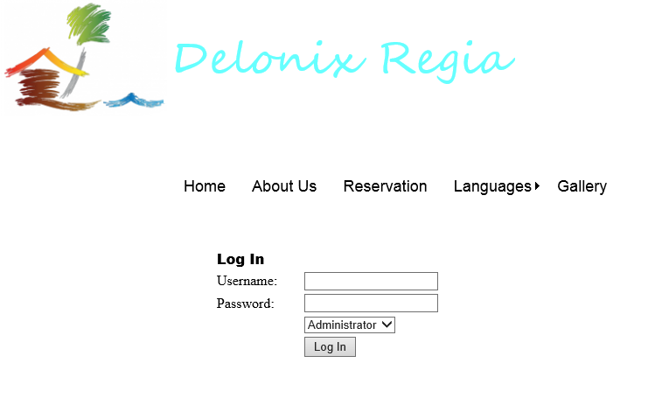
Log in

Slide 8
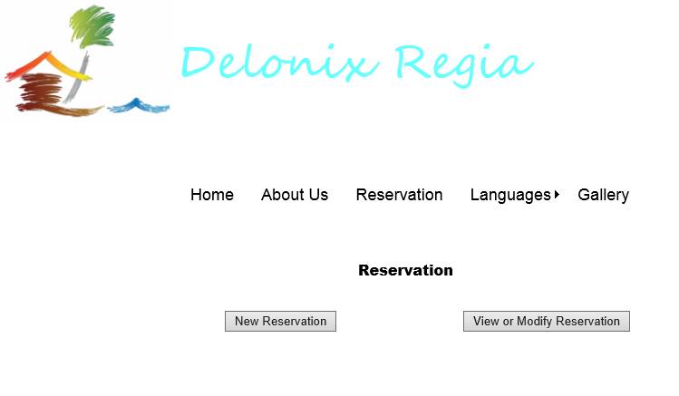
Reservation

Slide 9
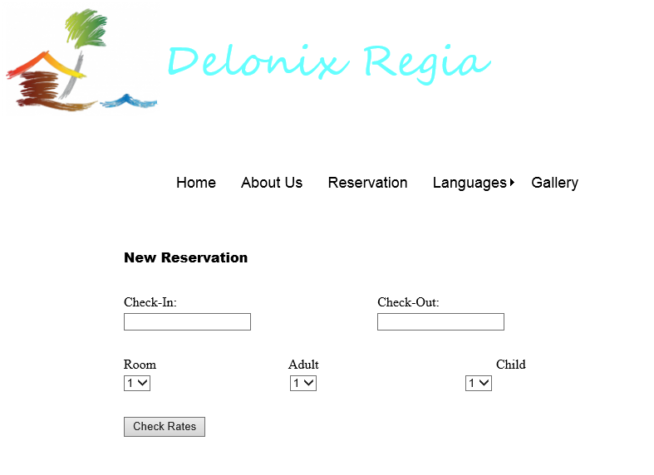
Reservation

Slide 10
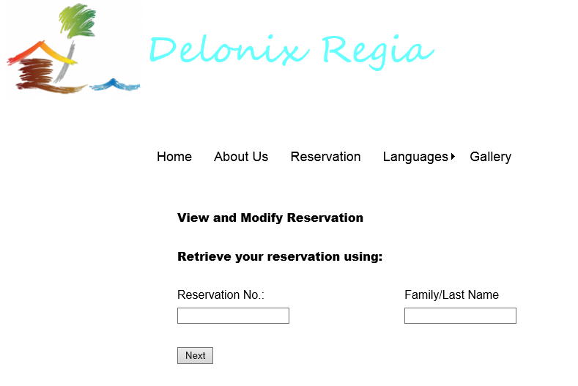
Reservation

Slide 11
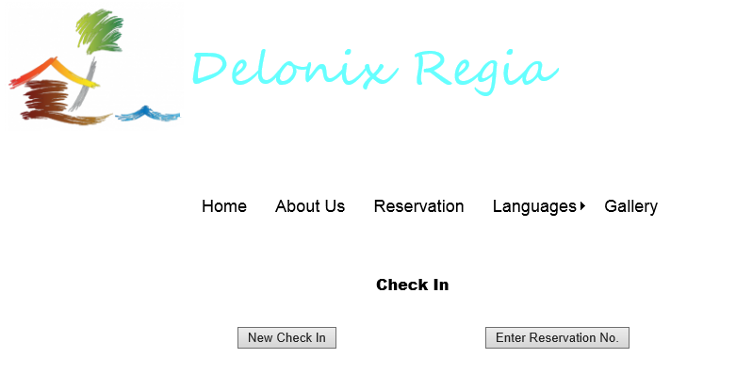
Check-in

Slide 12
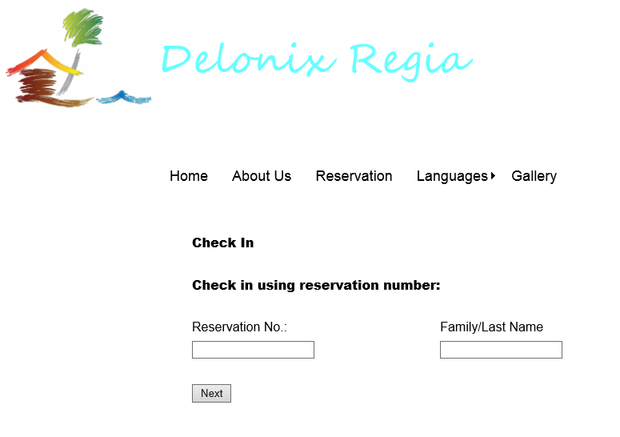
Check-in

Slide 13
Check-in

Slide 14
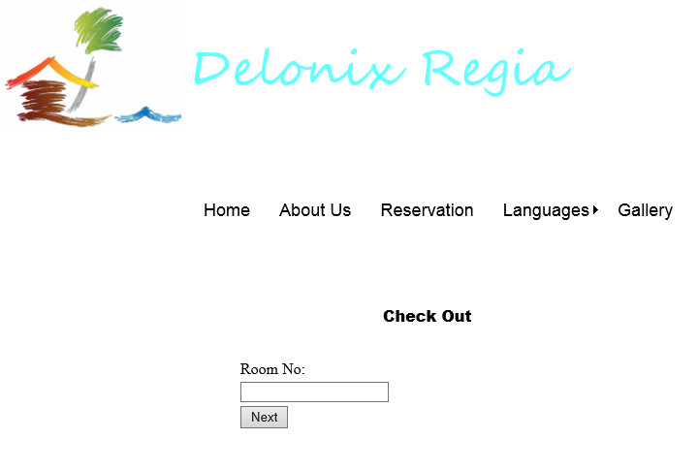
Check-out

Slide 15
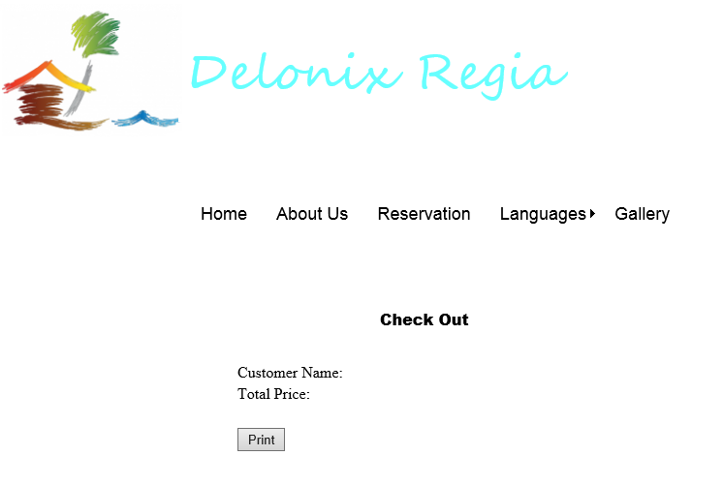
Check-out

Slide 16
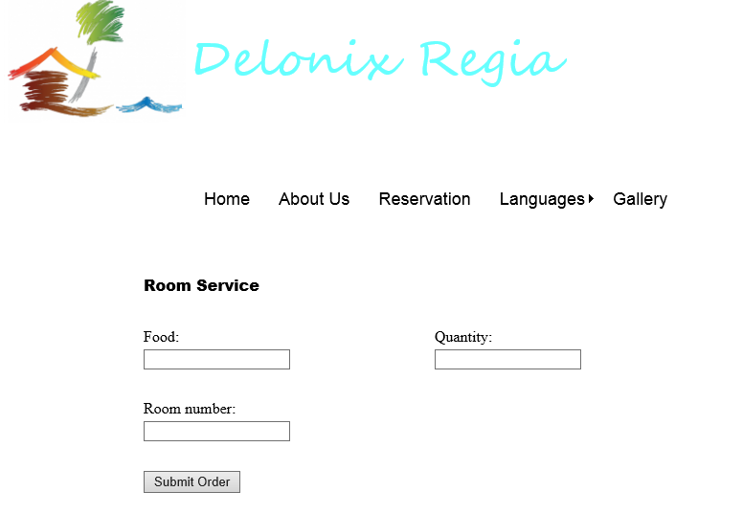
Room Service

Slide 17
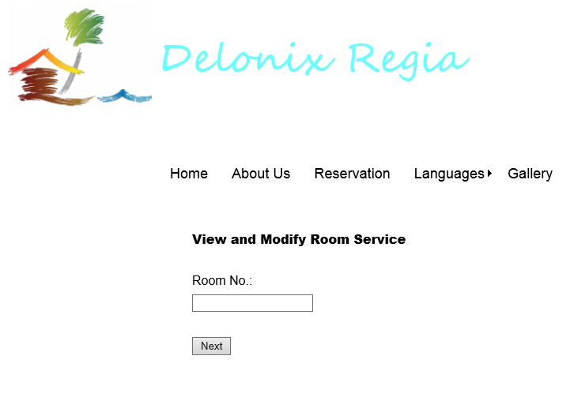
Room Service

Slide 18
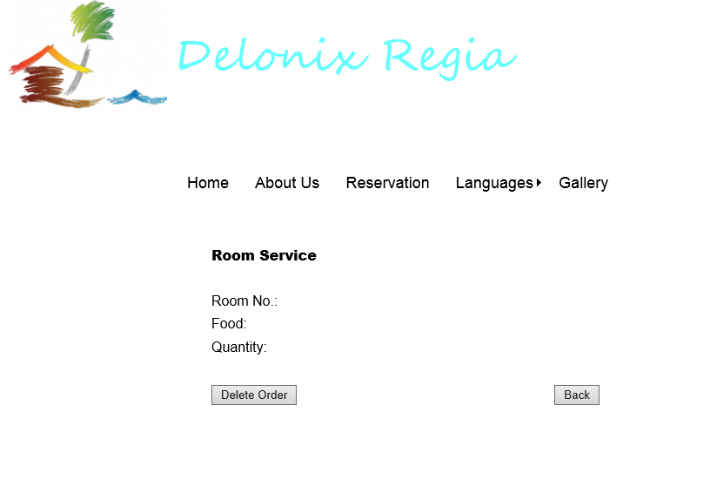
Room Service

Slide 19
Interface with Other Systems
Data Transfer
Secure sockets will be implemented for all transactions made online this includes confidential information of customers.
Data Storage
Account log-in is required to retrieve, create, update and delete information stored in the database.
The propose hotel management system’s databases will be encrypted.

Slide 20
Operating Environment
Integrated Development Environment (IDE)
Pantheon Systems
Visual Studio 2010 (Web applications)
Eclipse Standard 4.3.2 (Mobile applications – Android platform)
OS X & IOS (Apple Mac Platform & Mobile platform)

Slide 21
Operating Environment
Hardware
1. Fully compatible with HP COMPAQ Tower Desktop PC – Computer used for reception staff area
- Intel® Pentium® 4 Processor 2.80 GHz, 512K Cache, 533 MHz FSB
- 1GB RAM
- 160GB Hard disk
- Windows XP Professional Edition Support Package 2 and above.
2. Any Android mobile devices - latest recommended android device (Samsung Galaxy S4)
- Android OS, v4.2.2 (Jelly Bean), v4.3, upgradable to v4.4.2 (Kit Kat)
- 1080 x 1920 pixels, 5.0 inches (~441 ppi pixel density)
- Supports up to OpenGL ES version 3.0
3. Any Mac OS & IOS devices (Apple Iphone 4 and above)
- Mac: OS X v10.6.8 or later
- IOS 7

Slide 22
Operating Environment
Operating system (OS)
1. Windows
2. Android
Web Services & Networks
Must have Internet Connection
Internet Information Services (IIS)
Virtual private network (VPN) – For hotel staff to access management modules
Database server
Microsoft SQL server management studio 2008

Slide 23
Development Constraint
System software constraints
Outdated systems software versions
Incompatibility between software such as the operating system and programming language
Issues with device drivers
Hardware constraints
Incompatibility between hardware and systems software
Hardware restrictions
Interoperability between hardware components

Slide 24
Performance
Dashboard
Runs on real time basis
Eg. If there is an update to an information in the database, changes will be made to all the information that are currently running simultaneously on other interfaces.
Reporting System
Take 1 to 3 minutes for a report to be generated. The longer report, the more time it takes to generate.
Eg. An annual report take a longer time to generate than a monthly report.
Invoice and Statement
Take around 1 minute for an invoice to be generated. The longer the invoice the more time it takes to generate.
Reservation system
Takes a single click/a second to create, retrieve, update and delete bookings and reservations

Slide 25
Performance
Login and Logout
Takes 3 seconds for a staff to log in or log out of the system normally
Takes 6 seconds for a staff to log in or log out of the system during peak hour
Global Perspective
Takes 2 seconds for all the language presented in the browser to be translated to another language
Flexible Payment
Different types of payments will always be available 24/7
Searching Rooms
Take 5 seconds for a list of available rooms that meets the user requirements to be generated
FAQs
Queries send to system will be answered and email back to the users within 3 working days.

Slide 26
Availability
The system is required to run 24/7. The down time for maintenance and data backup will be at everyday 3am.

Slide 27
Security and Access Control Requirements
Access:
3 main functions of the system:
Room availability & booking module,
Housekeeping & staff management module and
the Reporting module.
The users who have access to certain function differs.

Slide 28
Security and Access Control Requirements
End users (reception staff)
Part access to reporting modules :
Room statues report
List all guest in a particular room report
List all guest in all rooms at any given time report
Full access to room availability & booking module:
Edit the guest records
View room availability
Have access to all of the data in the room availability & booking module

Slide 29
Security and Access Control Requirements
Management users
Full access to room availability and booking module, housekeeping and staff management module and reporting module
Administrators
Full access to room availability and booking module, housekeeping and staff management module and reporting module
Additional access to user account and login creation module
Gain control over all the accounts of the system (both guests and staff accounts)
Easily remove or add new accounts with this access

Slide 30
Security and Access Control Requirements
The areas that would require logging for auditing purposes would be:
When editing booking information. Every time, a cancellation of room booking or changing the booking period/ booking rooms. We would log the date and time of changes and the changes made.
When staffs changes guest records. We would log the date and time of changes along with changes made.
Every staff login. We would log the date, time, username and password (encrypted) of login.

Slide 31
Security and Access Control Requirements
The areas that would require logging for auditing purposes would be:
Every booking made. We would log the date, time, username and the booking details.
Whenever any changes to any account’s personal information was made. We will then log the username, date, time, the changes made
Registration for staffs. We would log the date, time, registration information and the administrator’s username.

Slide 32
Security and Access Control Requirements
Other Security
There are many other security considerations besides auditing and logging. These are some other security measures we would be implementing in the software:
Encrypting/hashing all passwords and sensitive information regardless of account type is a must.
A limited amount of tries for user login before locking the account for some time to prevent un-authorized personnel from entering the account.
Implementing CAPTCHA during registration of accounts is necessary to prevent spam and bots.
Encrypting data transfers (SSL)
Using session timeouts. Give limited time for customer users to stay logged on. This is for preventing hackers targeting unlocked accounts.
Send users their log files through emails every week. So that users can verify the actions they did on that week.

Slide 33
Software Design Specification

Slide 34
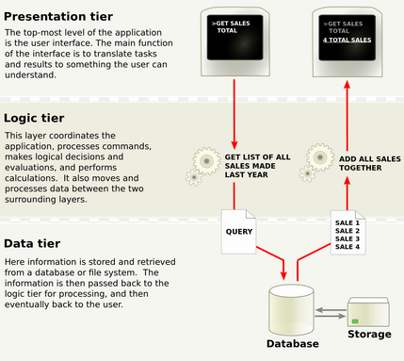
Architecture Design
3-Tier Architecture: Consist of a presentation tier, a business logic tier and a data access tier
The functional process logic, data access, computer data storage and user interface are developed and maintained as independent modules on separate platforms. It allows any one of the three tiers to be upgraded or replaced independently.

Slide 35
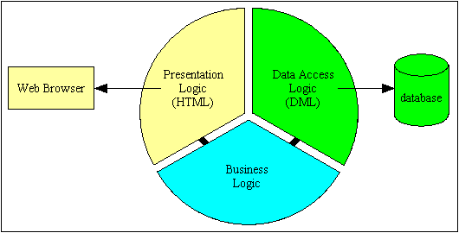
Architecture Design
Presentation Tier
Top most layer of the Hotel Management System
Responsible for the user interface of the system which deals with the display of information related to services such as checking the room availability or making a reservation for rooms
Created with ASP .NET Web Application in C# using Visual Studio 2012
Business Logic Tier
Middle tier of the three-tier architecture
Business logic such as the data required would be defined in this tier
Responsible for the information exchange between the user interface and the database of the system
System mainly consist of the users such as customers, hotel owners, staff and system administrator of the Hotel
Data Access Tier
Final and last tier of the three-tier architecture
Database server of the system is located in this tier
All the information that the system required are stored and retrieved from here
Microsoft SQL Server 2012 is used to create the database of the system for this proposed hotel management system

Slide 36
Advantages of 3-Tier Architecture
Scalability:
Can be deployed on many machines.
Database does not requires a connection from every client
Reusability:
The specific language of implementation of the middle tier can be made transparent if an standard object is employed
Improve Data Integrity:
Middle tier ensure that only valid data is allowed to be updated in the database
Improved Security:
Data layer is more secure as client does not have direct access to the database
Business logic is more secure as it is placed on a more secure central server
Reduced Distribution:
Changes to business logic only need to be updated on the application servers and does not have to be distributed to all the clients
Improved Availability
Mission-critical applications can make use of redundant application servers and redundant database servers, so it can recover from network or server failures

Slide 37
Disadvantages of 3-Tier Architecture
More complexity/effort
Point of communication are doubled

Slide 38
USER INTERFACE (UI) DESIGN
Consistency
Group things effectively
Be purposeful in page layout
Strategically use color and texture

Slide 39
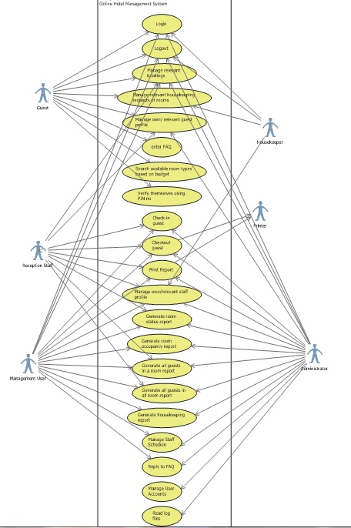
Use Case
Login
Logout
Manage relevant bookings
Manage relevant housekeeping requests of rooms
Manage own/relevant guest profile
Enter FAQ
Search available room types based on budget
Verify themselves using PIN no
Check-in guest
Checkout guest
Print Report
Manage own/relevant staff profile
Generate Room Status report
Generate All Guests in a Room report
Generate All Guests in all Room report
Generate Room Occupancy report
Generate Housekeeping report
Manage staff schedule
Reply to FAQ
Manage user accounts
Read log files

Slide 40
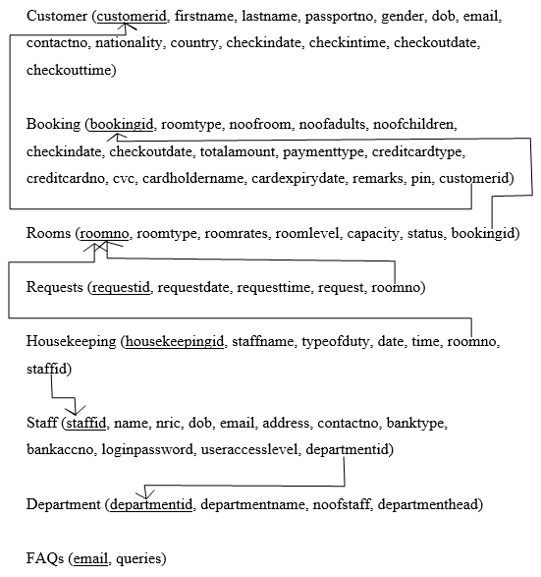
Database Schema

Slide 41
Limitations
Data complexity
The database is complex, difficult and time-consuming to design, if data types are poorly chosen, it will create unnecessary complexity or limit the future development of the database
Broken keys and records
If different data types used to link the unique key spread across several tables are different, the database will not be able to link the information without additional rework by the report developer.
If a table does not have a unique key, the database might also return inaccurate results.

Slide 42
End of Presentation

